Slide 1
Telco customer churn Prediction
Using machine learning

Slide 2
objective
Telecom industry become very competitive in present days. Customers shift their network to service provider who provide the best or better service then others.
Our project aims to develop a machine learning model to detect the churn customers
In this project, build a model by machine learning algorithms which gives best accuracy

Slide 3
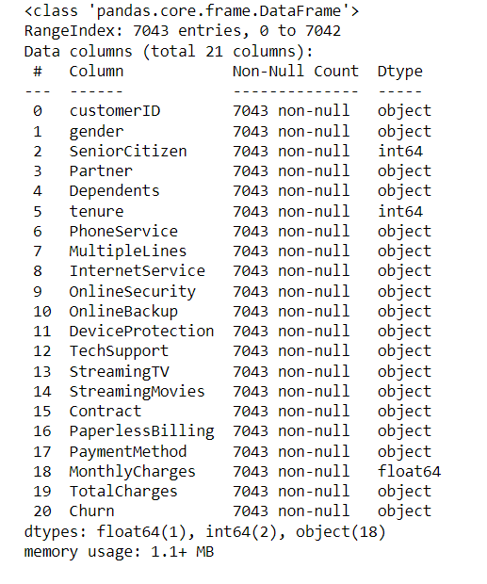
Dataset
Mentor provided dataset is used to develop the machine learning model.Below are the information about given dataset

Slide 4
Data preprocessing/cleaning
Checked for null values ,no null found.
Checked for duplicate records, not found.
Trimmed data in dataset to remove extra spaces
Removed unwanted columns like customer id.
Converted categorical columns into numerical data.
Convert into required datatype
Checked for outliers by data visualization, not outliers found

Slide 5
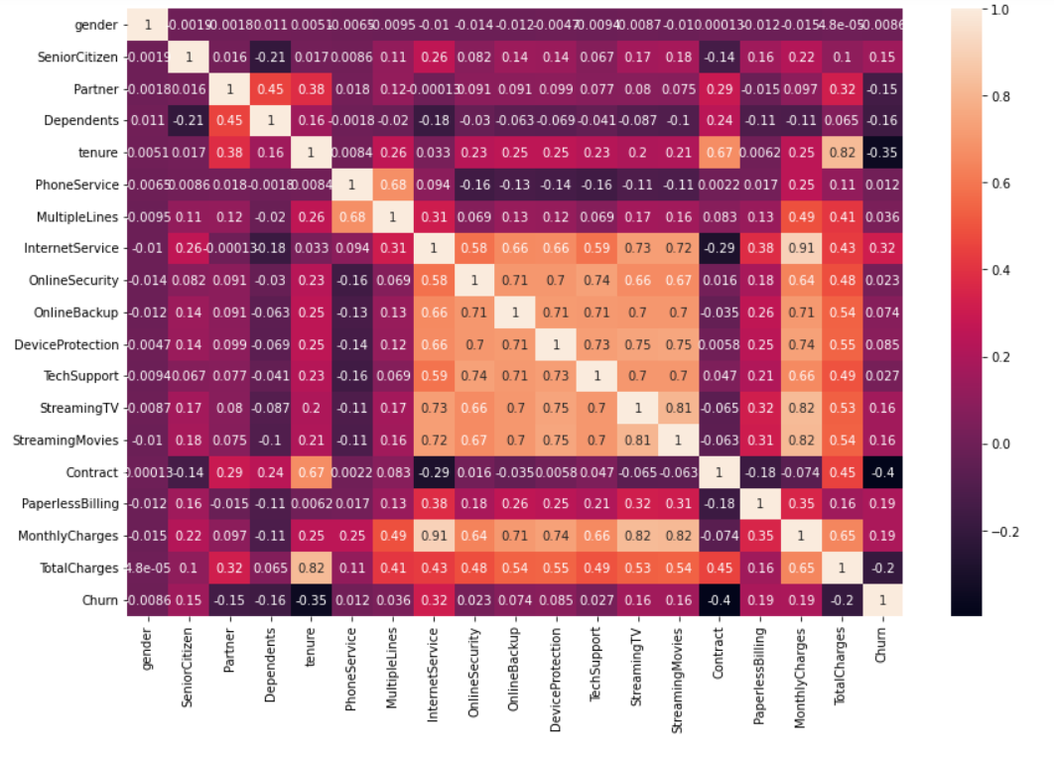
Co-relation matrix

Slide 6
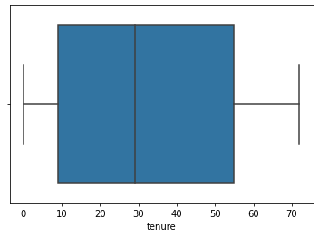
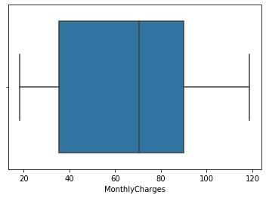
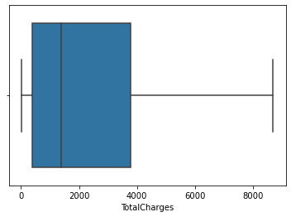
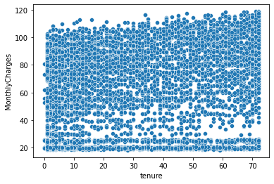
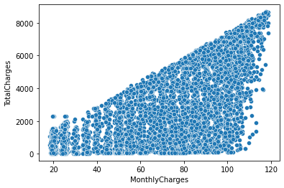
Data visualization

Slide 7
Model Building
Split into dependent and independent features
Then dataset is split into train and test datasets
Linear Regression , Lasso, Ridge, KNN, Random Forest, Decision Tree, SVM models are used for prediction

Slide 8
accuracy
At last accuracy given by models are
KnNeighbors :80.8374733853797 %
SVM :73.52732434350603 %
Decision Tree :100 %
Random Forest :100 %
Logistic Regression:76.01135557132718 %
Conclusion
Random Forest and Decision Tree Gives High accuracy than other models

Slide 9
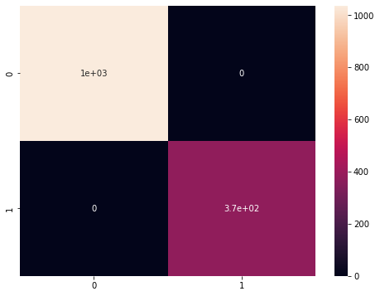
Confusion matrix

